Slide 2


Coronavirus
Worship Leaders Assembly
2

Slide 3
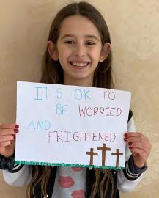
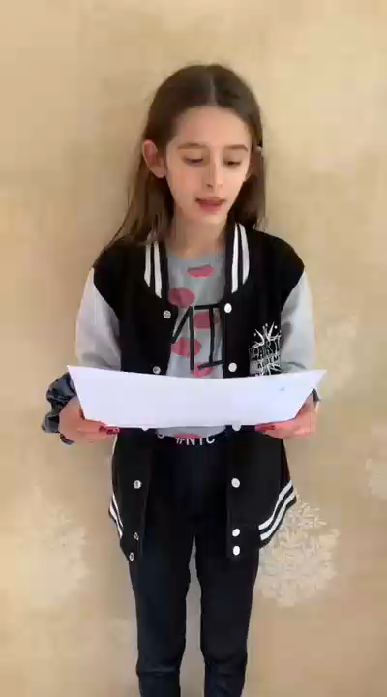
Welcome…
Worship Leaders Assembly

Slide 4
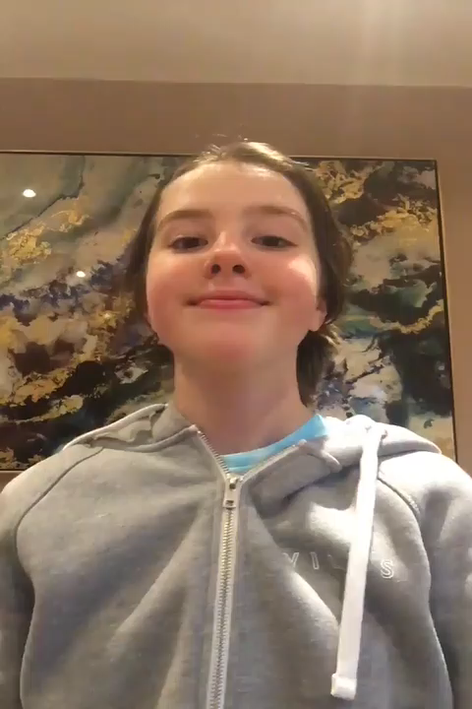
We will now read some inspirational quotes:
Worship Leaders Assembly
4

Slide 5

We will now read some inspirational quotes:
Worship Leaders Assembly
5

Slide 6

We will now read some inspirational quotes:
Worship Leaders Assembly
6

Slide 7
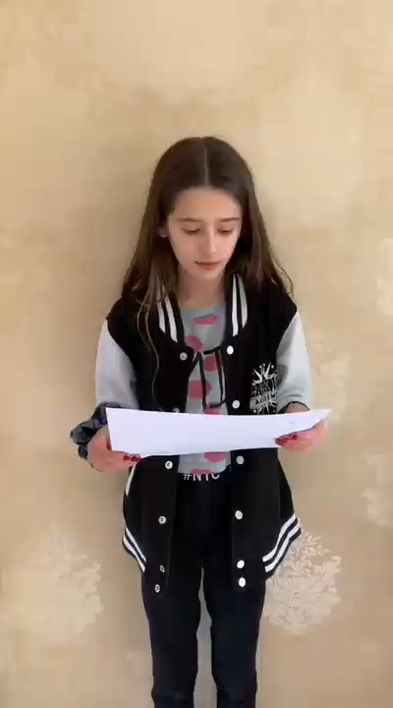
We will now read some inspirational quotes:
Worship Leaders Assembly
7

Slide 8
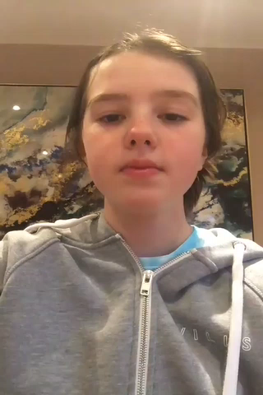
By now we all know quite a lot about this new virus,
known more specifically as Covid 19 or
coronavirus. We know that sometimes it’s been
hard to buy food in our shops and this may
mean we can’t get our favourite things for a
while.
Worship Leaders Assembly
8

